Slide 1
When Digital Meets Information Literacy: What We Can Learn from Following the Research Processes of Individual Students
A roundtable sponsored by the MLA Bibliography Unit
Annual Convention of the Modern Language Association, Chicago, January 4, 2019
Sandra Jamieson (Chair); Janice Walker (LILAC Project); Michele Van Hoeck (Project Information Literacy); Rebecca Moore Howard (Citation Project); Jordan Canzonetta, Diana Fidaoui, & Jason Markins (Citation Project: Students and Their Sources)

Slide 2
When Digital Meets Information Literacy
Sandra Jamieson (Chair): “Introduction: Research and replication: the importance of building on and extending research.”
Janice Walker. “Searching for Sources: LILAC Project research and what RAPs reveal about students' research process.”
Michele Van Hoeck. “Research Behaviors: What Project Information Literacy (PIL) surveys and interviews reveal about student motivation and strategies.”
Rebecca Moore Howard. “Writing from Sources: What Citation Project research tells us about student source use (and misuse) in bibliographies.”
Jordan Canzonetta, Diana Fidaoui, and Jason Markins, “Students and their Sources: What the SATS Research team has learned from following a group of students from library searching to paper submission.”

Slide 3
Searching for Sources: LILAC Project research and what RAPs reveal about students' research process.
Janice Walker
Georgia Southern University

Slide 4
What Students Actually Do
Students are looking for quick solutions to their “primary” research question: How do I satisfy the requirements of this assignment?
They do not want books (unless books are required—which is when they WILL go to the library).
They want articles (even if they don’t always understand what an “article” is, and even if they aren’t reading more than the first page or two).
And they believe their research and evaluation skills are good.

Slide 5
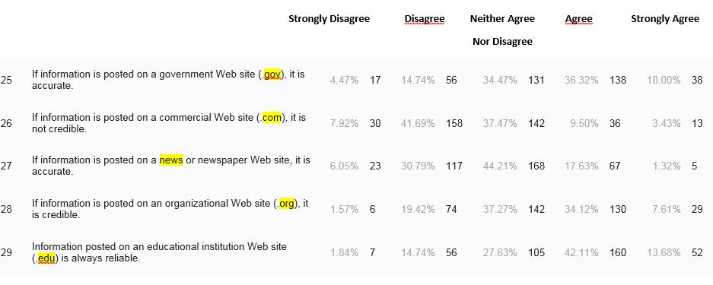
The Usual Obligatory Statistics

Slide 6
Next Steps
RAP videos are available as a freely available repository posted to YouTube for use by students, instructors, researchers, or others, and
We are now working on coding the videos and analyzing the coded data and questionnaire results.

Slide 7

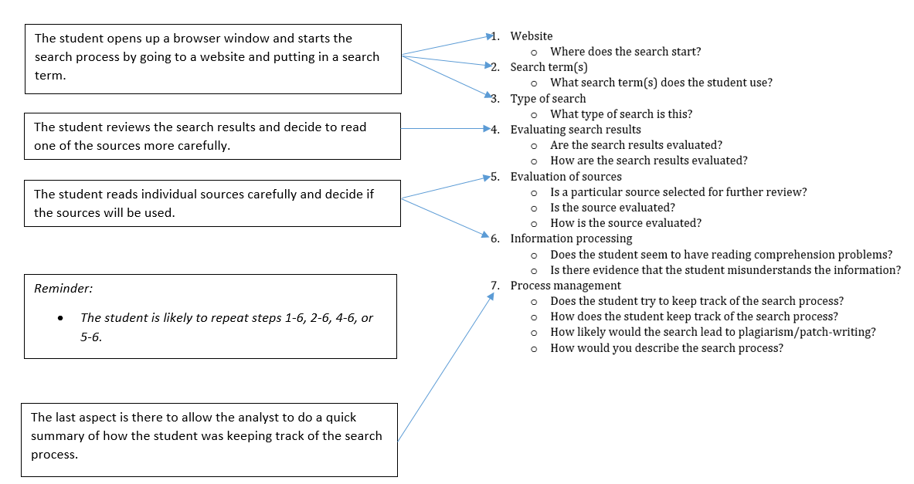
Notes:
The coding scheme is developed to examine characteristics of students’ information-seeking behavior in the following 7 aspects. Each aspect is considered as a category in the coding process, with guiding question(s) to help guide the coding process for each.

Slide 8
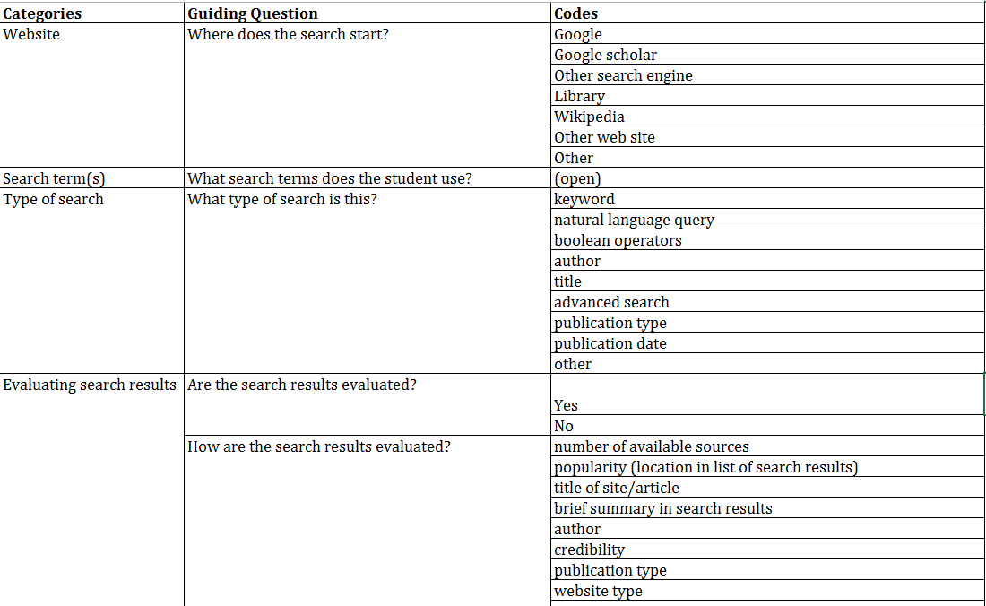
Notes:
Here are the codes for each of the categories.

Slide 9
LILAC Links
RAP Videos :
Link to LILAC YouTube channel
https://www.youtube.com/playlist?list=PLYjDllyxxE_iyxK7WypiRIML_lAJBD6Z4
(or go to YouTube.com and search for Janice Walker LILAC)
Other Links:
Link to shared Google Drive:
https://drive.google.com/open?id=0BxZpkR9VKf3wdS1LVEdLTllRQXc
LILAC Blog: http://lilac-group.blogspot.com/
Follow us on Twitter: @lilacproject
Join us at the annual Georgia International Conference on Information Literacy:
https://academics.georgiasouthern.edu/ce/conferences/infolit/

Slide 10
Research Behaviors
What Project Information Literacy (PIL)
surveys and interviews reveal
about student challenges and strategies
Michele Van Hoeck
California State University Maritime

Slide 11

Project Information Literacy
A large-scale study about early adults and their research habits
http://projectinfolit.org

Slide 12
Ten PIL Studies
22,000 students, 89 US campuses
focus
groups
online surveys
handout technology
analysis interviews
workplace freshmen lifelong
learning
learning news
spaces engagement
2008
n = 86
2009 2010
n = 2318
n = 8353
2010
n = 191
2011
n = 560
2012 2013 2014-15
n = 23 n = 35 n = 60
n = 33 n = 1941 n = 4000
2016 2018
n= 49 n=5844
Notes:
This is a snapshot of PIL’s work. We’ve done a mix of quantitative and qualitative studies, the largest being a survey of over 8,000 college students, the smallest a set of interviews and focus groups with employers and college graduates. There’s no way I could summarize all these studies in 10 minutes, and no way you’d want to hear me try. Instead, I’m going to call out three key findings from the first nine studies, plus two from the most recent study related to undergrads and news engagement.

Slide 13
How Do Students Feel About Research?
“Adjectives that describe how you feel when you get a research assignment?”
fear,
angst,
tired,
dread,
excited,
anxious,
annoyed,
stressed,
disgusted,
intrigued,
confused,
overwhelmed
2009, n = 86 | 7 campuses
Notes:
This early focus group finding sums up why I’m involved with PIL. I’ve wanted to find out how to elicit “excited and intrigued about research” rather than the other adjectives

Slide 14

Getting started- the hardest part of course research
#1

Slide 15
WHAT TASKS ARE MOST DIFFICULT?
Task
definition
Using
Information
Self
assessment
Search
Search
69%
41%
30%
25%
Getting started
(84%)
Defining a topic
(66%)
Narrowing a topic (62%)
2010 survey, n = 8353 sophomores, juniors, seniors

Slide 16
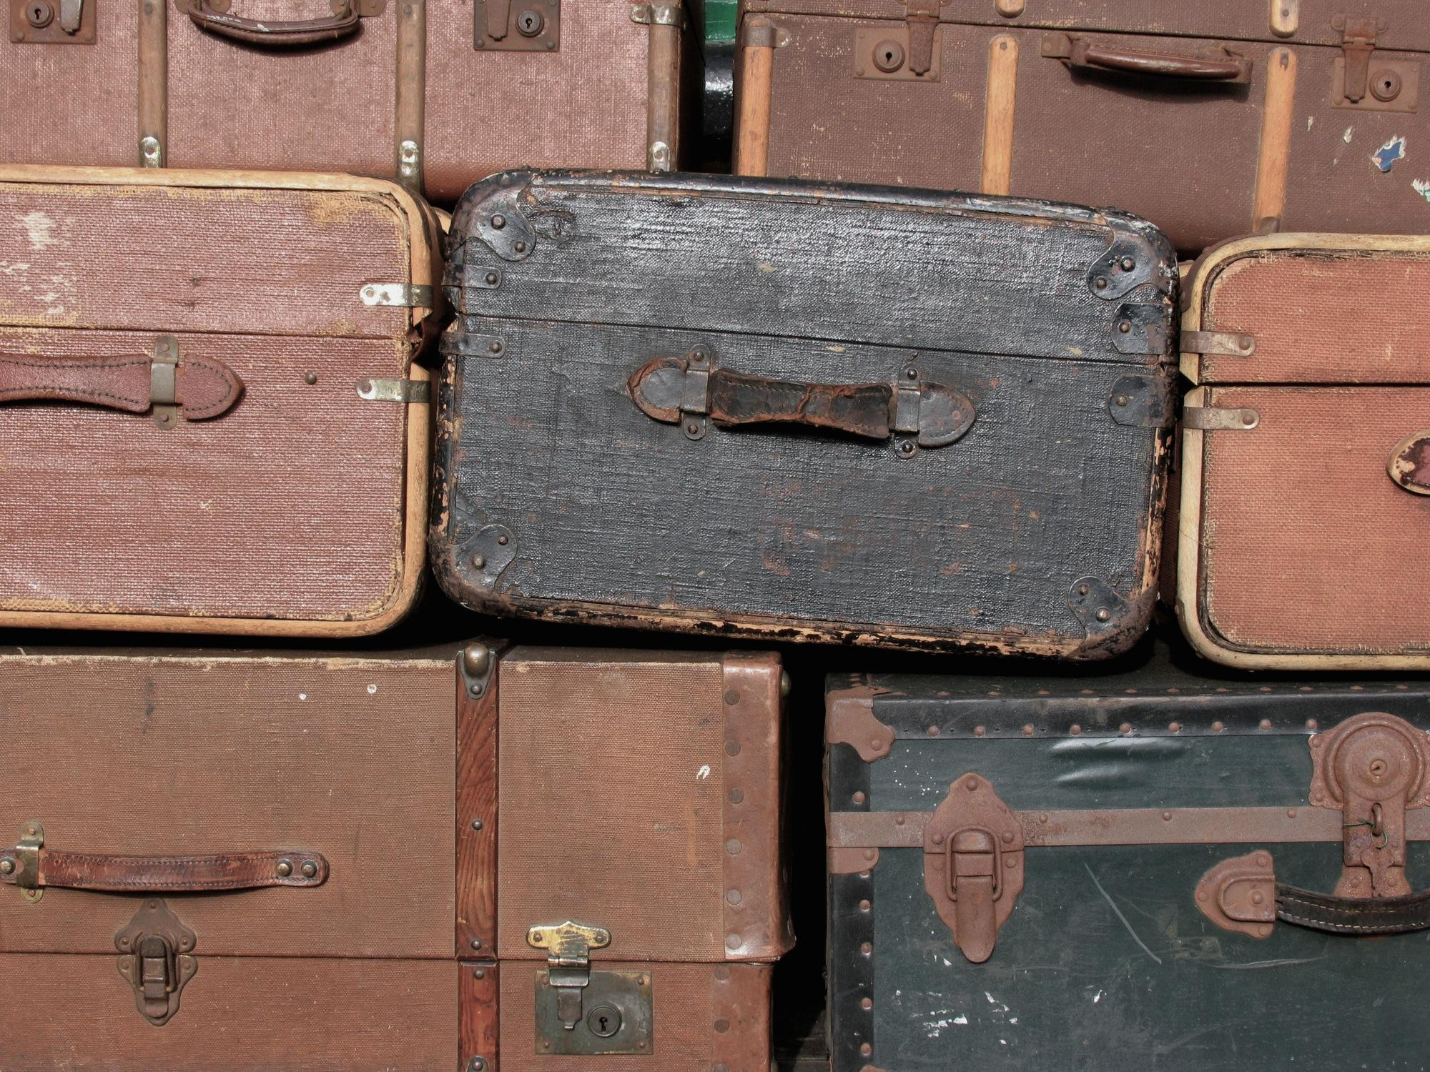
#2
STUDENTS
USE THE
SAME FEW
GO-TO
SOURCES
Notes:
This is not news, but what’s interesting is hearing from students about why so many of them are reluctant to go beyond their trusty few

Slide 17
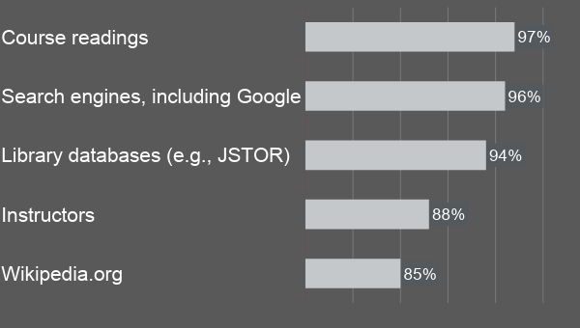
SOURCES MOST USED
2010 survey, n = 8353 sophomores, juniors, seniors

Slide 18

RESEARCH STRATEGY = RISK AVOIDANCE
Predictability
Familiarity
Efficiency

Slide 19
A FAMILIAR PATH…
Situational context
Instructor’s handout
Course readings
Google, Wikipedia
JSTOR
etc.
Instructors
Big picture &
Language contexts
For a novice, research = finding context

Slide 20
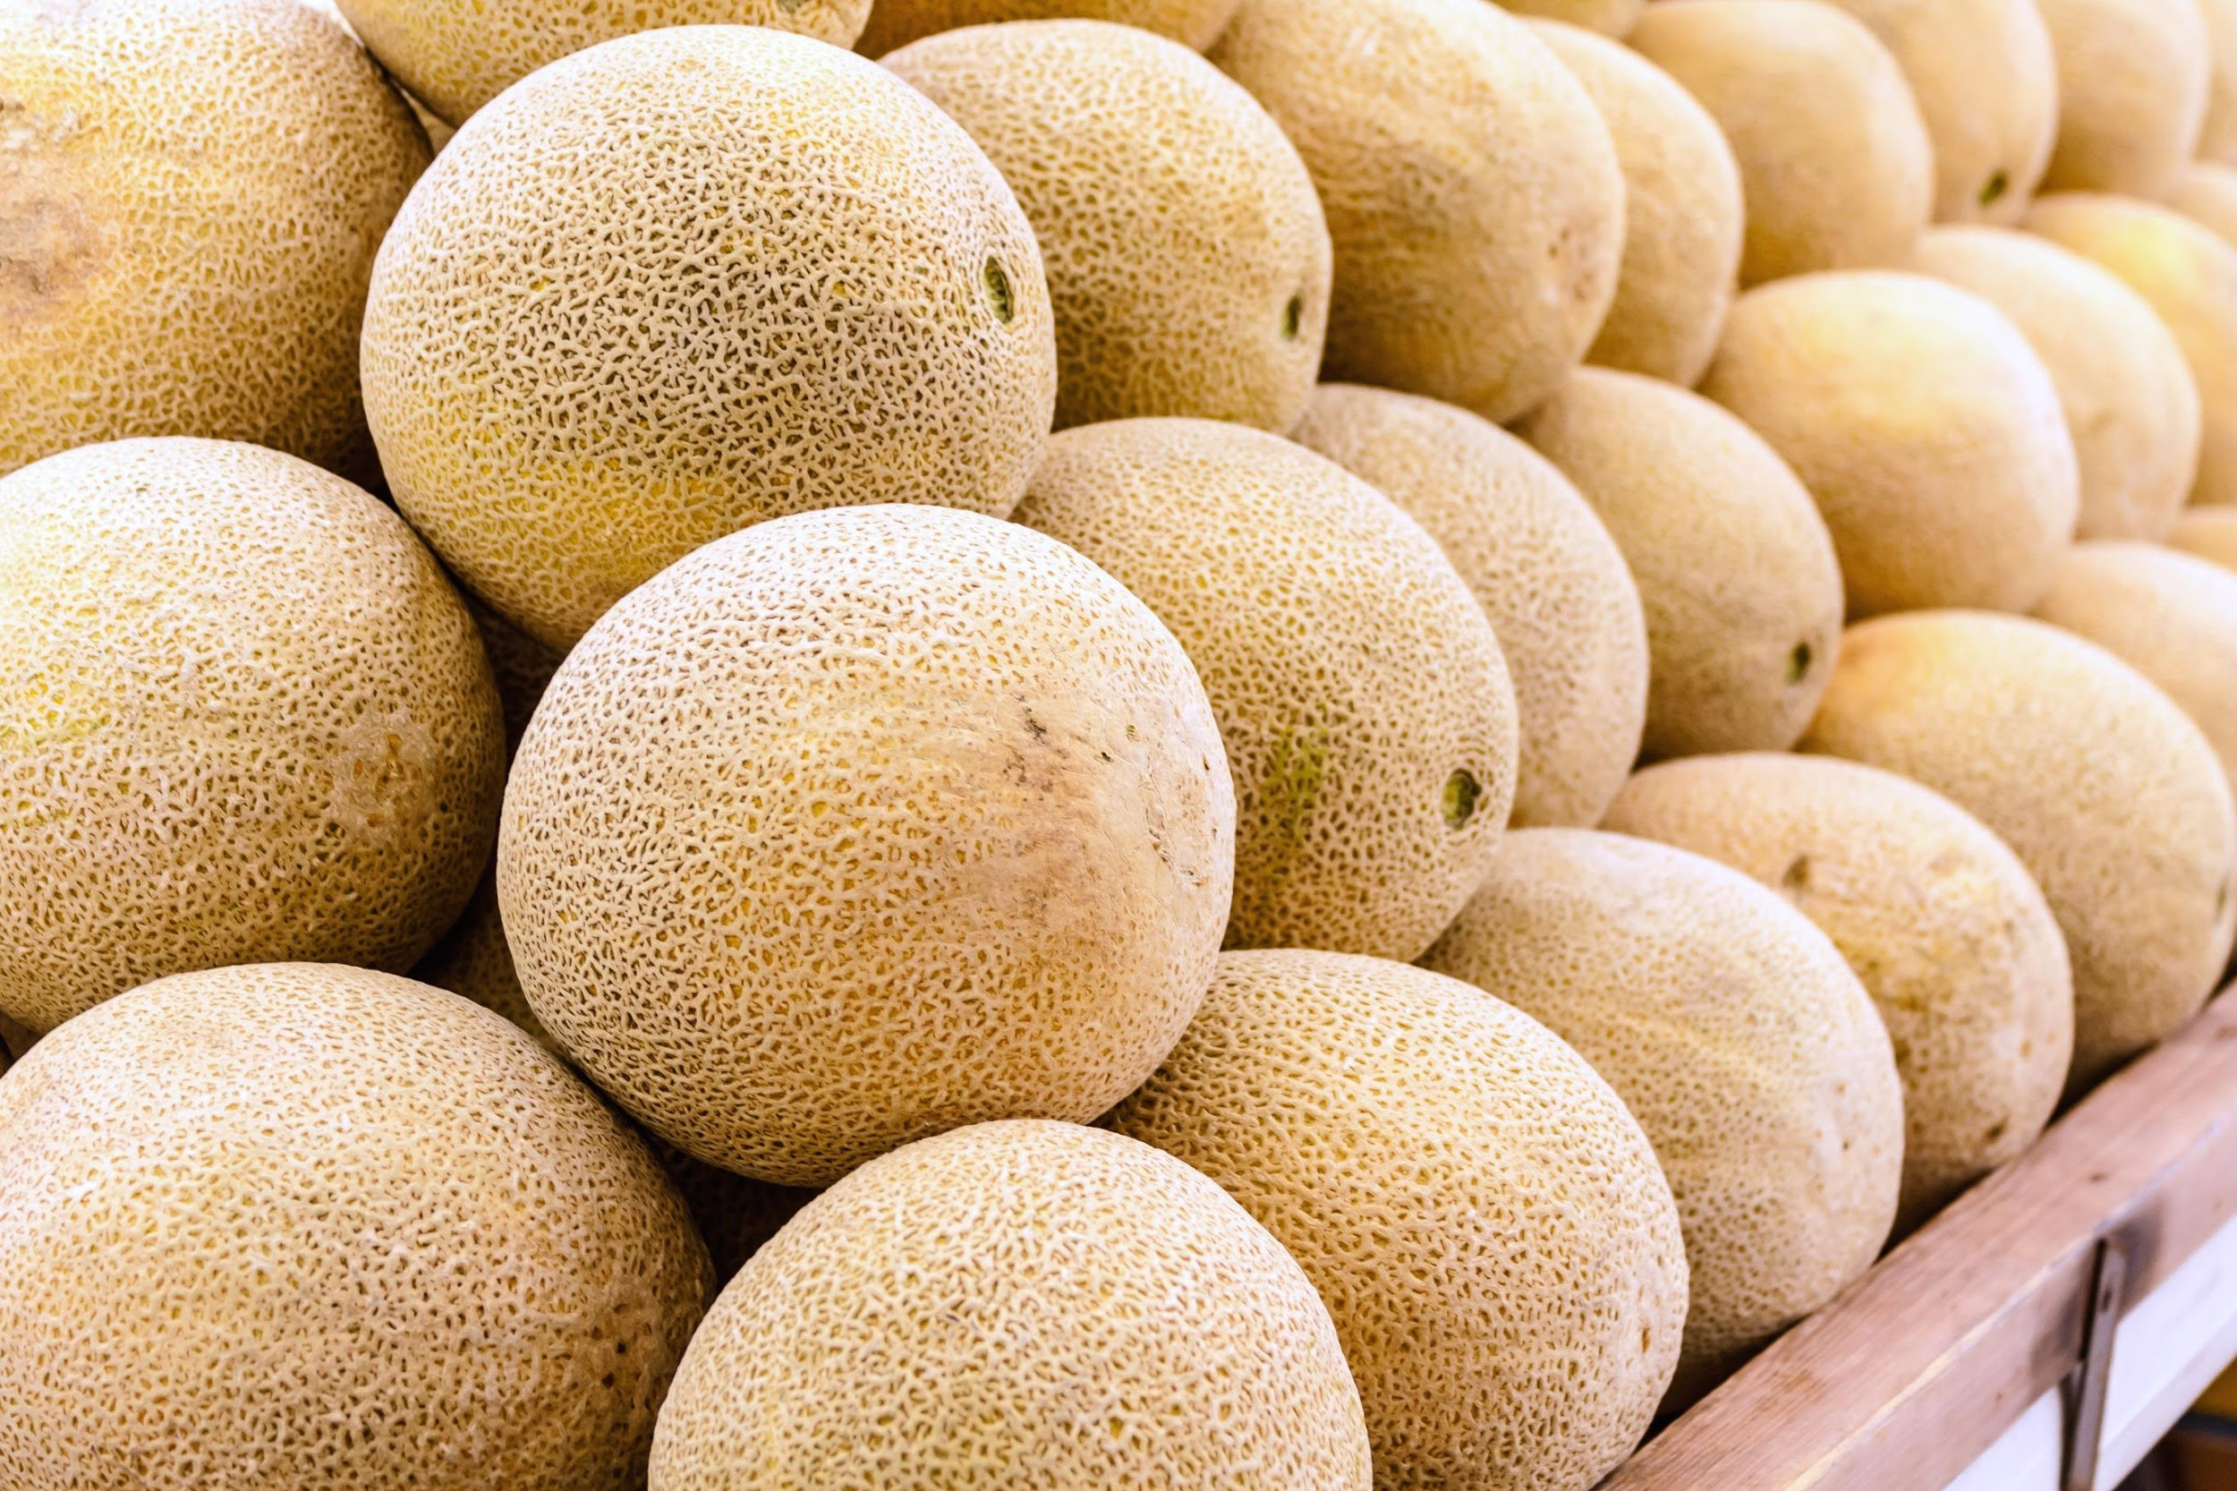
#3
Evaluation
skills
transfer
beyond
graduation

Slide 21

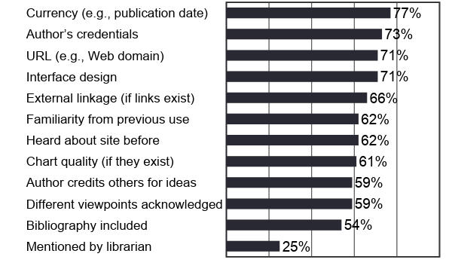
Evaluation criteria: Coursework
2010 Truth Be Told survey, n = 8353 | 25 campuses

Slide 22
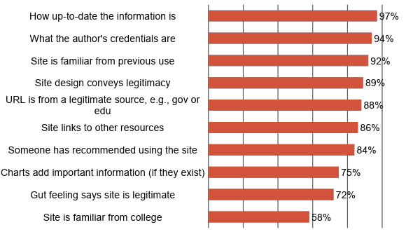
Evaluation criteria: After graduation
2015 Staying Smart survey, n = 1651 | 10 US campuses

Slide 23
Graduate focus groups:
What skills transferred to post-college life?
Ability to:
Systematically evaluate sources
Critically analyze published sources
Synthesize large volumes of content
2012 Learning Curve graduate focus groups, n = 33 | 4 US campuses

Slide 24
2018 News Engagement Study
Many pathways to news:
  93% discussions with peers
  89% social media
  76% online newspapers
  70% discussions with professors
Idealized view of journalism vs. distrust of news
  80% say news is necessary for democracy
  58% had shared news in the previous week
  36% said “fake news” made them distrust credibility of any news

Slide 25
Project Information Literacy
A large-scale study about early adults and their research habits
http://projectinfolit.org

Slide 26
Writing from Sources
What Citation Project research tells us about student source use (and misuse) in bibliographies.
Rebecca Moore Howard
Syracuse University

Slide 27
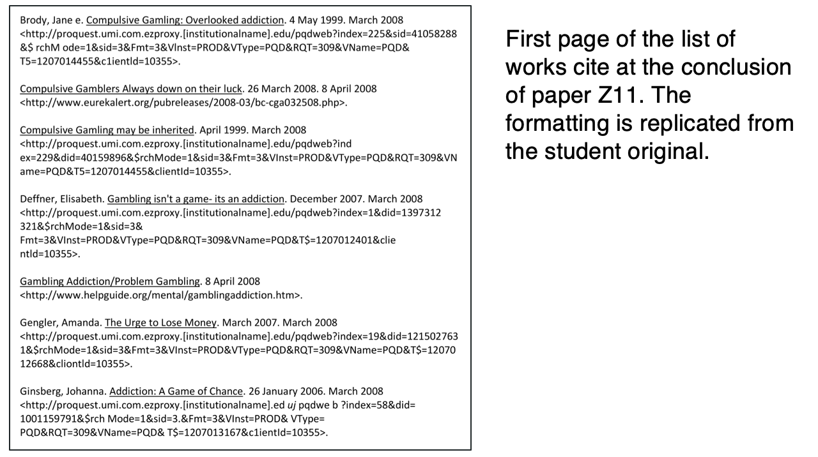

Slide 28
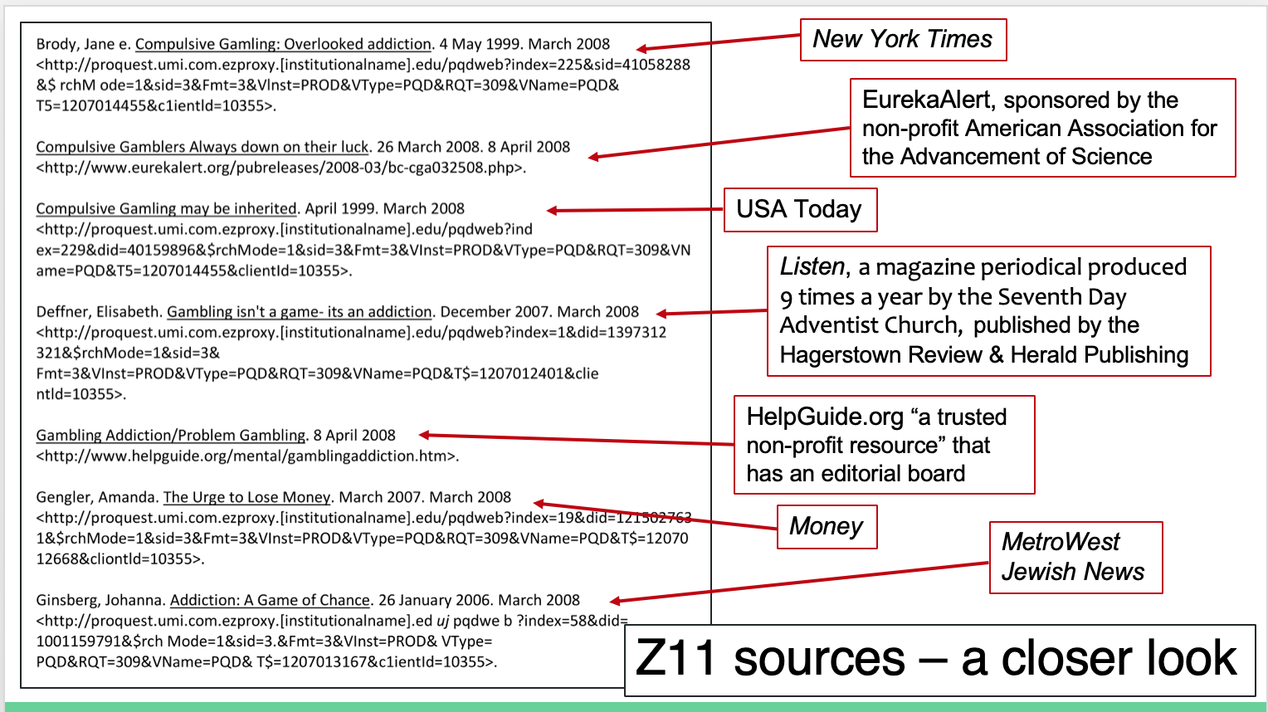

Slide 29
Students and Their Sources: Assumptions and surprises from a study of students’ research and metacognitive process
Jordan Canzonetta, Diana Fidaoui, & Jason Markins
Syracuse University
Notes:
set up who the three of us are and very brief overview.
SATS grad team: Jordan Canzonetta, Diana Fidaoui, and myself (Jason Markins)
For the next five minutes or so, I am going to give a very brief introduction of some of the main talking points for the three of us. We are a part of a larger team—many of whom could not be here—but, we represent different key areas in the project and can speak to those.
There are three main points I will hit on and then will turn to Diana and Jordan to say more during the Q&A. The three points we are focusing on today are on the early surprises we encountered with their usage of technology, the complex moments of metacognitive thinking we are seeing, and the pedagogical connections to some of the “Aha! Moments we are seeing in pilot study.

Slide 30

Methods
Technologies
Camtasia and Screen-Recording Technologies
Dropbox
GoogleDocs
Screen capture
Survey
Interviews
Notes:
I am here as a representative of the technology team, along with Sandra Jameison and Noah Wilson, and others. We were responsible for some of the planning decisions that went into the technology. Here we see the variety of technologies we used as a team and that we were asking student participants to use.

Slide 31
Students and Technology
Our Initial Expectations:
We assumed students would focus on a primary task while occasionally straying to social media, email, etc.
What We Found:
Students’ usage of online technologies were complex, multifaceted, and much more interconnected than we expected.
Notes:
In terms of our experiences with technology, we went into the project with a great deal of planning and designs that were based on our assumptions that students would struggle to use Camtasia—our voice and screen recording technology, and instead we found that they frequently used it intuitively and what we found were several examples of students navigating a variety of technologies and platforms at a time. We were expecting to find them focused on a task with occasional distractions or interruptions as they used social media. Instead, what we find is that they are using numerous platforms at once. They are bouncing back and forth between a number of platforms, from google docs, blackboard, other classes, Youtube, social media, etc but they were often navigating these technological spaces in ways that are not accounted for in most descriptions of students’ technology use. Their social media use wasn’t necessarily a distraction but imbedded in their work as they use a number of other classes or collaborative spaces to research.

Slide 32

Metacognition
Our Initial Expectations:
Students would struggle to name and explain their research practices
What We Found:
Students are articulate and fluent describing and rationalizing research process.
But, they struggle with articulating how to determine a source’s credibility and how they use their sources.
Notes:
At first, we thought students would struggle rationalizing and talking about “how” they move through their research process. What we actually found was that students were very articulate and explicit about naming and explaining their research practices, but that they struggled to articulate how they knew which sources to use beyond describing them as intuitive or, “I just know from experience” how to use a source or if it isn’t credible.

Slide 33
Introspection
“Don’t be mad at us if we use Google because we grew up with Google, and we grew up really knowing how to use it... we could be more trusted with [Google] than [instructors] think.”
Notes:
Students are being responsible and nuanced with how they use Google. Even though we know students typically only engage with the first page of Google search results, they use the resources they find to lead them to other citations, key terms, and relevant information about their projects. Sometimes, Google investigation will lead them to their institutional library, where students will engage with scholarly and academic resources.

Slide 34
Reflection
A student’s own words on her research process:
“Reflection was challenging in [research writing] at first...I consider myself to be a pretty strong writer. When I had to go through and reread it, I felt like I wasn’t making enough mistakes. Reflecting on it and reflecting on my process was probably the most challenging. And learning to draft more, because I don’t really like (other than right before I start to do the research) to do an outline because the way I find I work best is I start immediately writing the rough draft and if I need more research for a certain paragraph, fine.”
Notes:
Even though we researchers could see how well students were engaging with reflection about their processes, they didn’t see it. They found the processes to be daunting, but they were actually excelling at it without knowing it.

Slide 35

SAMPLE INTERVIEW QUOTE
Interviewer: What do you mean by paraphrasing?
Student 1:
“The most basic definition that you learn when you’re young is just you see someone’s argument and just saying it in different words, and I think that’s a little kind of problematic, maybe because that just teaches, oh say it different so you don’t get slapped for plagiarism, you know that’s when they’re first introducing you . . . I don’t like paraphrasing, it’s hard, it’s stressful because I don’t want to be plagiarizing anyone.”
Notes:
notes?

Slide 36
SAMPLE INTERVIEW QUOTE cont
Student 1 Continued:
“. . . generally it it’s something that’s really long and complicated, I try not to paraphrase it because I don’t… because then I feel like kinda dirty, because this is so much their words, I really need to attribute it. So if I’m gonna be paraphrasing something long, I’ll generally have like a footnote with it because it’s so clear the other person, so like, if you’re copying, if you’re using an idea that is several sentences long, even if I’m not writing it word for word although it’s still their idea, footnotes are your friends.”
Notes:
Notes? You need to unpack this because the student seems to be saying that she doesn’t think you need to cite paraphrase but she footnotes it amnyway just to be on the safe side. But what, for her, indicates that it is plagiarism?. Is that how you took this? Or that she is afraid of patchwriting?
I cut and moved material from this slide to make it more readable - but feel free to put it back!
I cut this material: I use footnotes judiciously. You know, that’s what I do,
I moved this to the last page: but yeah I don’t like paraphrasing, it’s hard, it’s stressful because I don’t want to be plagiarizing anyone.

Slide 37
SOME PEDAGOGICAL IMPLICATIONS
Information-seeking pedagogies need to focus on the search process for sources on Google, and particularly:
The meaning of sources that result from the search
The selection of sources that result from the search
Writing pedagogies need to focus on the meaning of:
Specific genres (e.g., literature review)
Summarizing, paraphrasing, and directly quoting
Notes:
Need notes here

Slide 38
Thank You!

